Slide 1
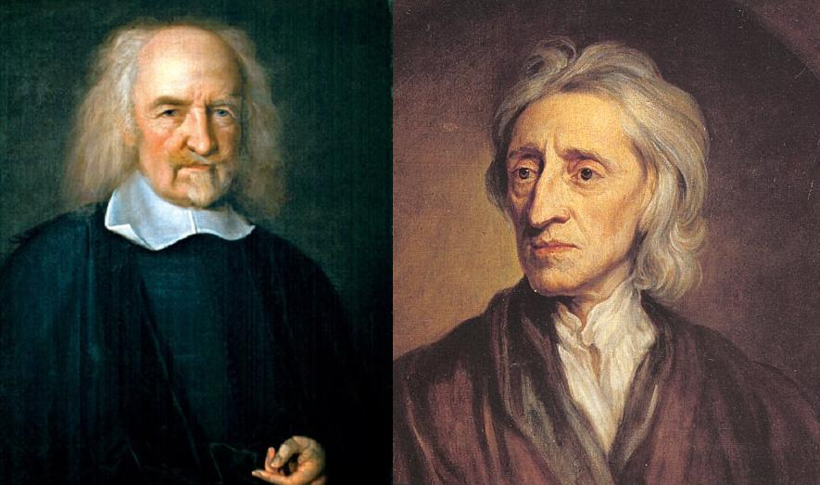
Hobbes vs. Locke
Comparing Philosophers of the 17th Century
Meera Aravinth, Jessica Baker, Joe Miller
10/1/14
Block: 5

Slide 2
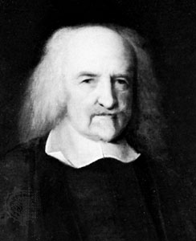
Hobbes Philosophy Thesis
“The right to govern derived from the consent of the governed and was a form of contract"

Slide 3
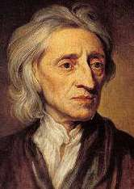
Locke Philosophy Thesis
“Due to political issues people should accept a sovereign government.”

Slide 4
Background - Locke
Grew up in a non-wealthy household
Studied at Oxford
Mathematician
Religion had huge influence on life
Wrote An Essay Concerning Human Understanding
Believed strongly in empiricism
Notes:
He became a tutor of the Earl of Shaftesbury... A Founder of modern educational theories, a politician, and a social thinker… in essay, rejected traditional way of knowledge and science, was extremely successful. In it he expressed his strong belief in empiricism: the theory that all knowledge is from self experience.

Slide 5
Background - Hobbes
Grew up in unpredictable environment
Mathematician and Social thinker
Tutor to royalty
Strictly materialistic view of the world
Wrote Leviathan
Notes:
Family wasn’t rich. Born in 1588, in the midst of reformation and the Spanish Armada. He didn’t pursue the church, but instead developed studies in mathematics and society. Tutored Charles II in math and the Cavendish family. This allowed him to travel to different countries and go deeper into his studies. Materialism is belief that all things are composed of material and all things that take place are the result of material properties. Both of their works in the 17th c. started a path for the rise of the Age of Reason

Slide 6
Hobbes’ Leviathan
Book published in 1651
Explained views on human nature and society
Effectively developed a vocabulary of English philosophy
Similar to The Prince by Niccolo Machiavelli
Notes:
Latin edition in 1668… like prince in the fact that it dealt with the structure of government… one of the earliest and most influential examples of the social contract theory - based on firmly established relationship between state and society

Slide 7
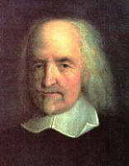
State of Nature
Hobbes
State of nature was brutal
Man exists in a state of war
Man is cruel, selfish, wicked
Locke
State of nature was kind
Man exists in freedom
Man is good nature

Slide 8
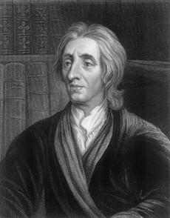
State of Nature Cont.
Hobbes
Must have an absolute monarch
Born with rights which are relinquished
Man has no regard for others
Locke
Man can self govern
Born with inalienable rights
Man does not harm others

Slide 9
Government
Hobbes
Purpose: impose law and order, control people
Absolute rule: people no right to rebel
Locke
Purpose: Represent people, secure their rights
People may rebel in certain conditions

Slide 10
Hobbes’ Government
Must have the powers of:
Legislation
Adjudication- legal process of judging disputes
Enforcement
Taxation
War-making

Slide 11
Social Contract
Hobbes
People give up rights
Govt. gives protection
outside invaders
criminals
Not allowed to question government
Locke
People give up right to punish people for crime
Govt. provides an impartial judicial system
Can rebel if ruler:
Seeks absolute power
Acts as judge of his own action
Goes to war with own people

Slide 12
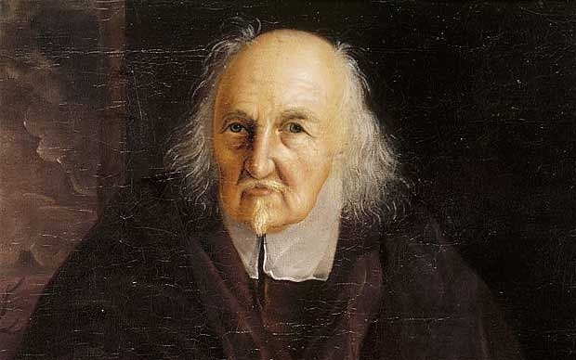
Influences on Society
Hobbes
Influenced government change
Both have profound influence on modern politics
Locke
Influenced American documents
Influential through first half of 18th c. in France
Notes:
Hobbes: To some degree influenced what can be done to change a government by the people
Locke: political doctrines affected American revolutionaries and the writing of the declaration of independence… rapidly lost influence in France when he was regarded as conservative, philosophy often misinterpreted and rejected

